Slide 1
Waterfall Software Development Model
By:
Alan Moe
Mark Mersenski

Slide 2
What is the Waterfall Software Development Model?
It is a planning approach that uses phases to outline the project requirements
These phases allow for the project to be broken out into managable pieces
The order in which each phase is completed is always the same
To move onto the next phase, the previous phase must be complete

Slide 3
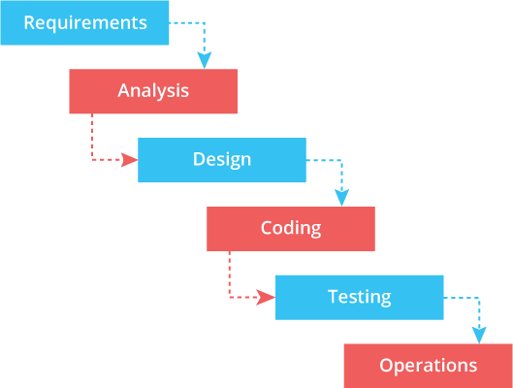
What are the phases?

Slide 4
Phase 1: Requirements
In this phase, the team will define the project requirements
This requires gathering requirements from the client/business side on how the application should work and from the team side on they are going to accomplish this work
All these requirements are prepared into a document and all teams must review and sign off on it
The document is the project guideline moving forward

Slide 5
Phase 2: Analysis
In this phase, the team will define the scope of the project, the stakeholders, business logic, and any constraints that might occur
This phase will provide a clear vision of the end product and help eliminate any of the grey areas in the project

Slide 6
Phase 3: Design
In this phase, the team will define the application/software design
These definitions will include:
Code architecture
Database setup
User interface and user experience
This information will drive the next phase...

Slide 7
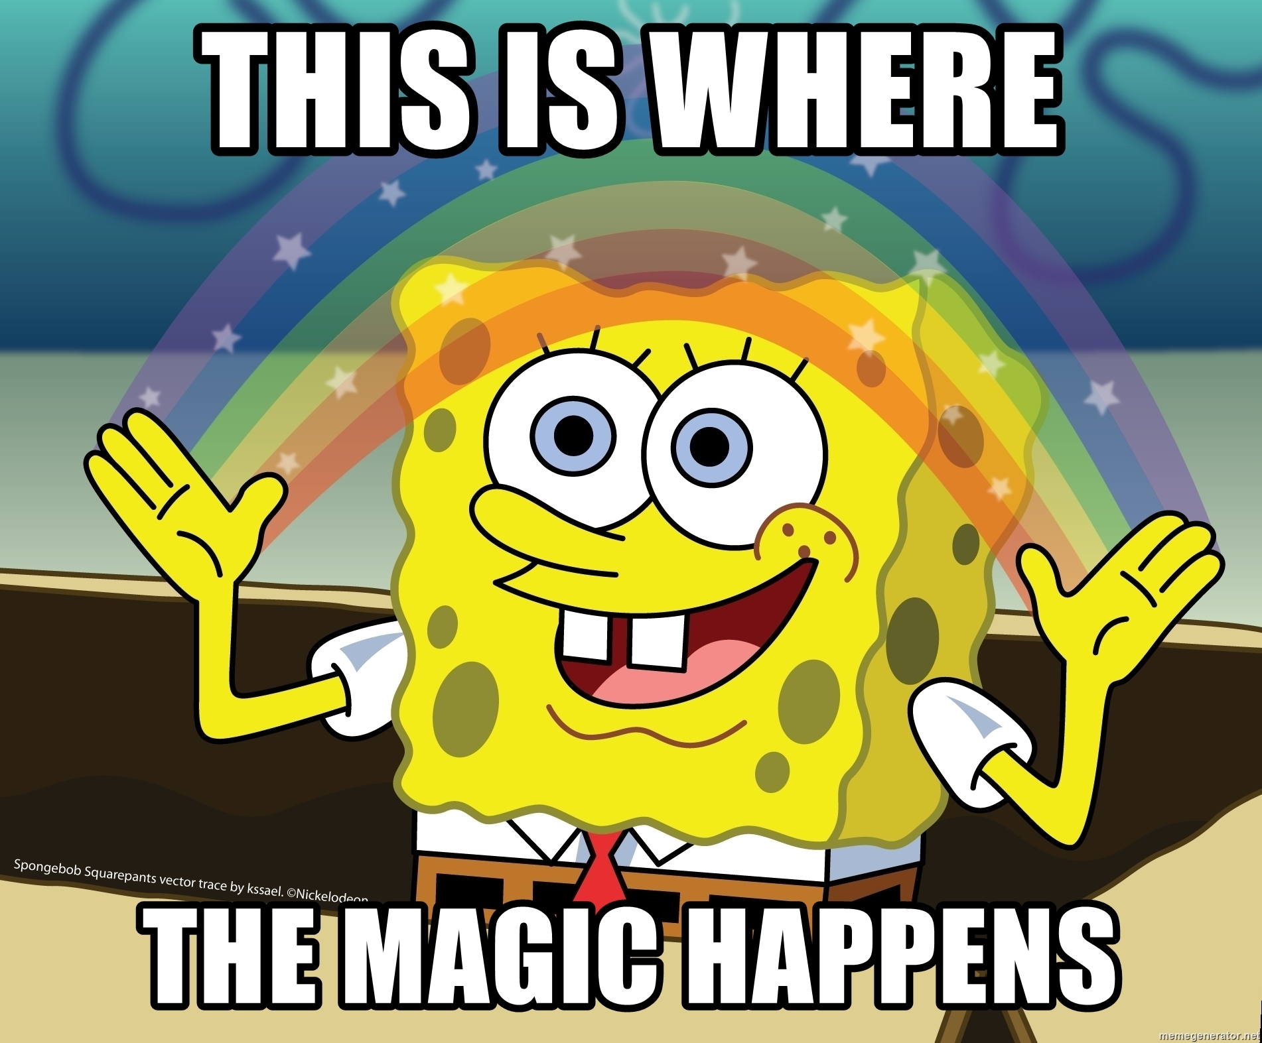
Phase 4: Coding

Slide 8
Phase 5: Testing
In this phase, the team will test the application
Testing requirements include:
Application runs as expected
Bugs and defects are documented
For any bugs/defects that are found, those will go back to the coding stage

Slide 9
Phase 6: Operation
In this phase, the team will plan the deployment of the application
Guidelines for support, and future enhancements, will also be determined

Slide 10
Advantages
Works for predictable, repeated projects
Logical structure is easy to understand
Thorough documentation great for new developers

Slide 11
Disadvantages
Lack of flexibility
Mistakes found later costly to fix
No working product until late

Slide 12
Conclusion
Great for:
predictable projects
new developers
Not so great for:
for time-sensitive projects
if you need to see something now

